Slide 1
Thesis Meeting 2.16.2021
Story Time

Slide 2
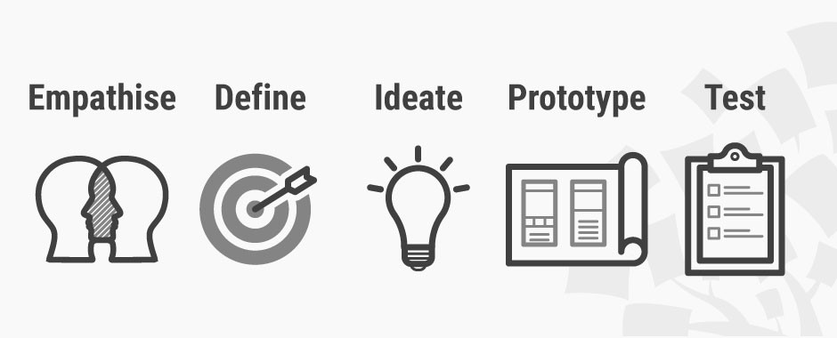
Design Thinking
Design thinking: processes used by designers to find the solution to complex issues, navigate new or uncertain environments, and create a new product for the world
Complex issue: aerophobia (rivals other conditions, such as agoraphobia and social phobia)

Slide 3

Ideate
Prerequisites: detailed observation of user, thorough diagnosis of needs and expectations, synthesis of user information
Goal: generate as many creative ideas as possible. Generating good ideas requires not only technical knowledge on the topic, but also ingenuity, courage and creativity. In order to facilitate this process, mitigating bias and maximizing idea generation (good and bad) are critical.
HMW Questions: way to frame your ideation, and often used for launching brainstorms. Goal: create questions that provoke meaningful and relevant ideas; do so by keeping the questions insightful and nuanced.

Slide 4

Utilization of Social Media Data
Social media have rendered the opinions and interactions among complex networks of individuals accessible and searchable
The massive amount of data generated by users using social media platforms is the result of the integration of their background details and daily activities.
Reddit viewed as favorable site for data analysis as topics are easily filterable and response length/content is not limited – site proved to generate ‘high-quality, expensive data’ in comparison to other platforms
Two data sets: 1) larger training data set of broader selection of Reddit threads/sub-reddits revolving around airplanes/air travel experience, 2) test data set of 180 posts from the Fear of Flying subreddit

Slide 5
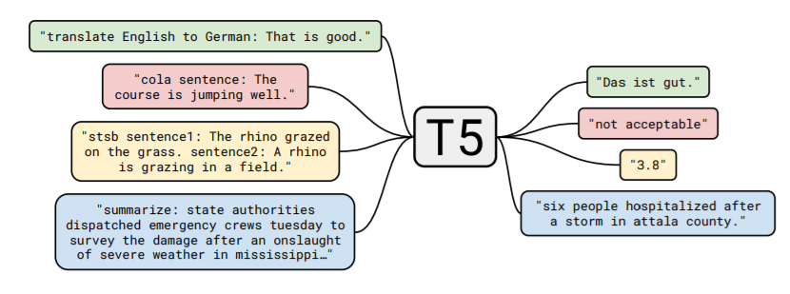
Summarization
Transfer learning: model is first pre-trained on a data-rich task before being finetuned on a downstream task
Downstream task: summarization across multiple Reddit samples
State-of-the-art results on many benchmarks covering summarization, question answering, text classification, and translation
Released publicly to facilitate future work on transfer learning for NLP

Slide 6

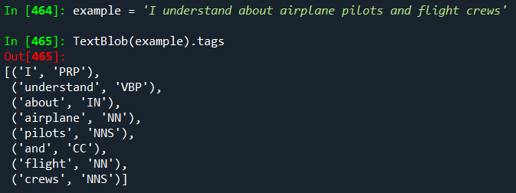
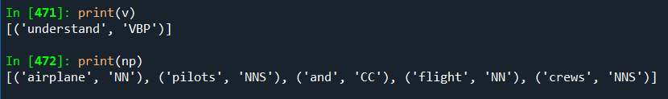
Initial Text Generation
Utilize textblob to tag parts of speech
Extract verbs + key noun phrases from the summaries
Generate an initial set of thousands of HMW questions quickly

Slide 7
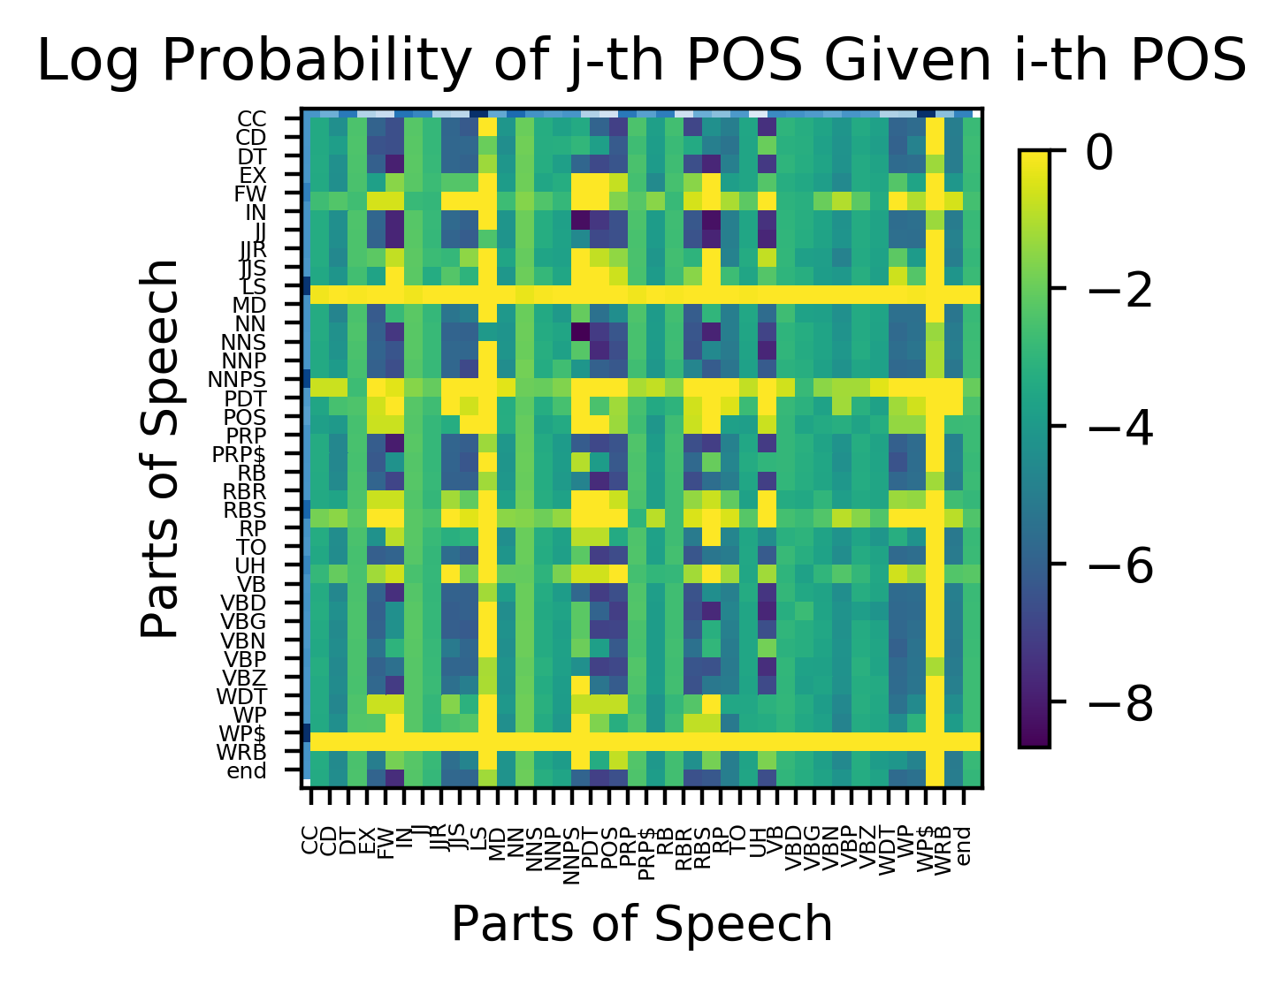
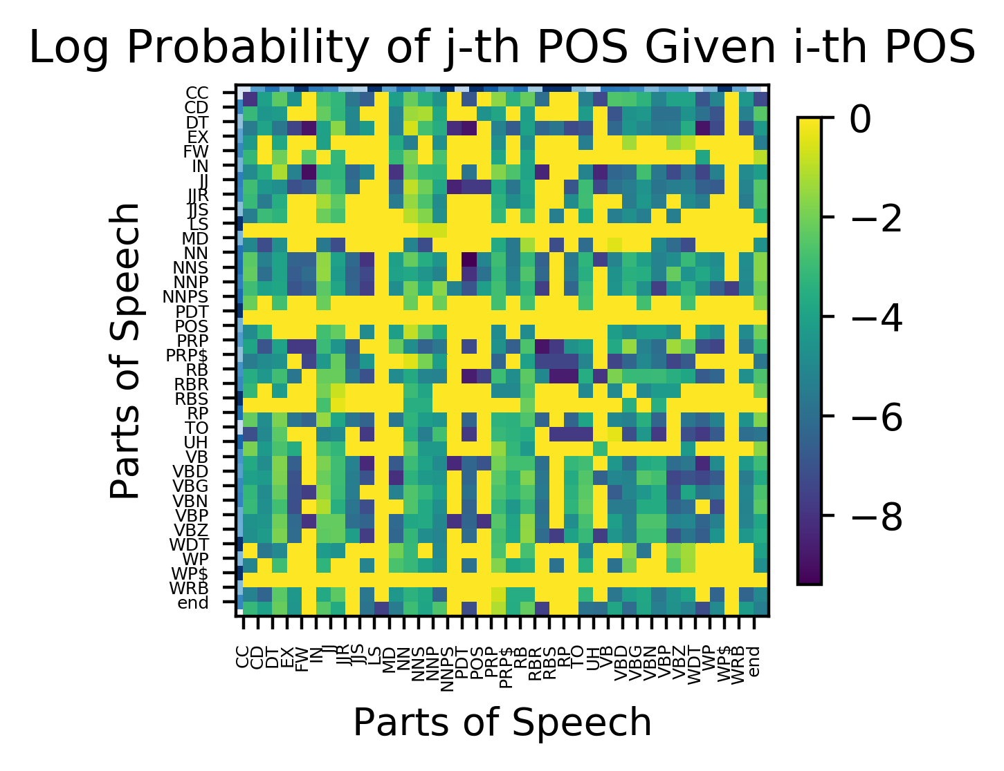
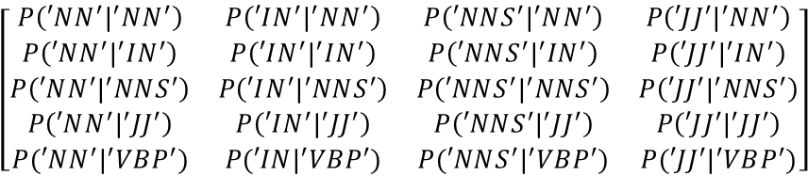
Markov Chains
'understand about airplane pilots and flight crews'
[('understand', ‘VBP’), ('about', 'IN’), ('airplanes', ‘JJ’), ('pilots, ‘NNS’), (‘and’, ‘CC’), (‘flight', 'JJ’), ('crews', 'NNS')]
‘NN’ ‘IN’ ‘NNS’ ‘JJ’
Natural Log Function
‘NN’ ‘IN’ ‘NNS’ ‘JJ’
‘VBP’
$$\left[\begin{matrix}P\left(′NN^{′}|^{′}NN^{′}\right) & P\left(′IN^{′}|^{′}NN^{′}\right) & P\left(′NNS^{′}|^{′}NN^{′}\right) & P\left(′JJ^{′}|^{′}NN^{′}\right) \\ P\left(′NN^{′}|^{′}IN^{′}\right) & P\left(′IN^{′}|^{′}IN^{′}\right) & P\left(′NNS^{′}|^{′}IN^{′}\right) & P\left(′JJ^{′}|^{′}IN^{′}\right) \\ P\left(′NN^{′}|^{′}NNS^{′}\right) & P\left(′IN^{′}|^{′}NNS^{′}\right) & P\left(′NNS^{′}|^{′}NNS^{′}\right) & P\left(′JJ^{′}|^{′}NNS^{′}\right) \\ P\left(′NN^{′}|^{′}JJ^{′}\right) & P\left(′IN^{′}|^{′}JJ^{′}\right) & P\left(′NNS^{′}|^{′}JJ^{′}\right) & P\left(′JJ^{′}|^{′}JJ^{′}\right) \\ P(′NN^{′}|^{′}VBP^{′}) & P(′IN|^{′}VBP^{′}) & P(′NNS^{′}|^{′}VBP^{′}) & P(′JJ^{′}|^{′}VBP^{′})\end{matrix}\right]$$
$$e^{\ln\left(P\left(A\right)\right)+\ln\left(P\left(B\right)\right)}=e^{\text{ln}[P\left(A\right)∗P\left(B\right)]}=P\left(A\right)∗P(B)$$

Slide 8
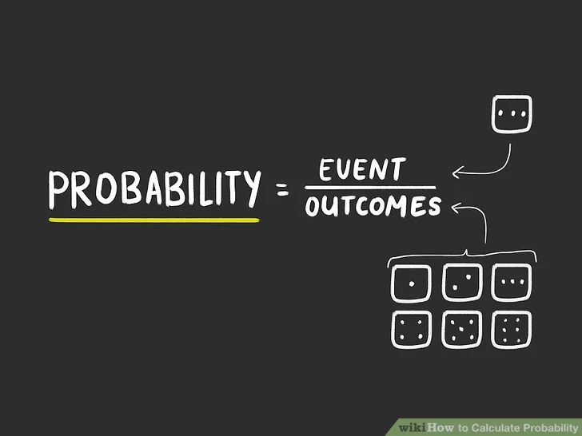
Calculating Probability
Avg Random POS Probability: 0.08240
Avg POS Probability: 0.1393
Avg Random Token Probability: 0.002951
Avg Token Probability: 0.003021
POS Scale Factor: 1.6905
Token Scale Factor: 1.0237
$${Probability: e}^{\ln\left(P\left(A\right)\right)+\ln\left(P\left(B\right)\right)}=e^{\text{ln}[P\left(A\right)∗P\left(B\right)]}=P\left(A\right)∗P(B)$$
Condition: If the probability of a sentence existing based on POS and Token chain analysis is greater than the probability of that same sentence existing based on a random POS and Token chain analysis times the POS and Token scale factors, then the sentence is considered legitimate.

Slide 9
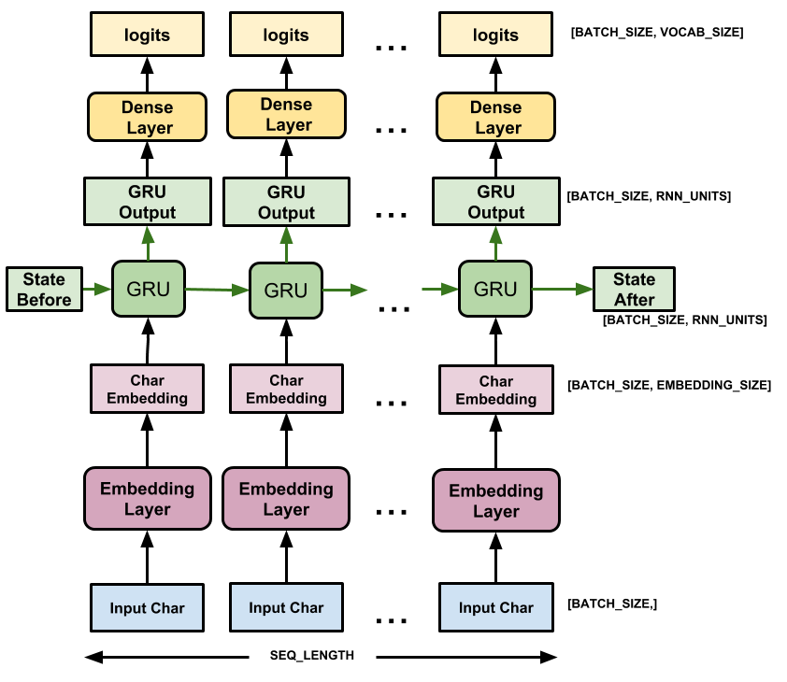
Tensorflow Keras API

Slide 10
Training
Ran through the night
100 epochs at roughly 15 minutes an epoch
Woke up only 30 epochs into first cycle
Laptop couldn’t access the internet
Decided to interrupt the run after morning classes
Re-ran quickly on 5 epochs but largely gibberish results

Slide 11
Methodology
keyword_comment_cleaned.csv
Training Data
Preprocessor
INPUT
Reddit_Samples.csv
Test Data
FUNCTION
TextBlob
Markov Model
Part of Speech Probability Matrix
Training Data
OUTPUT
Markov Model
Token Probability Matrix
END RESULT
Test Data
Google T5
Summaries
TextBlob
HMW Fragments
Part of Speech Probability Matrix
HMW Questions
Tensorflow
Keras API
HMW Questions
Better
HMW Questions
HMW Questions
Token Probability Matrix
Repeated n times

